Slide 1
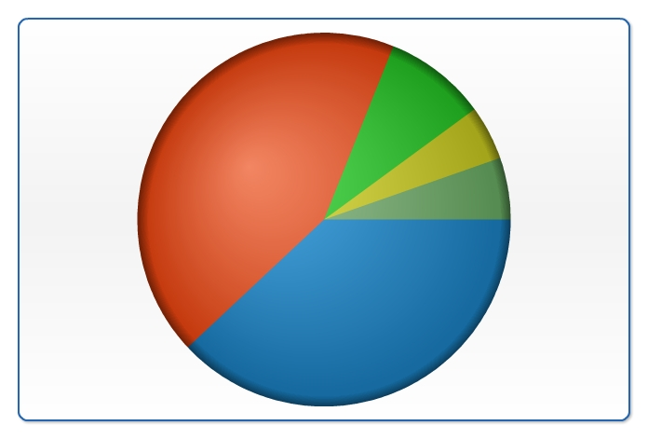
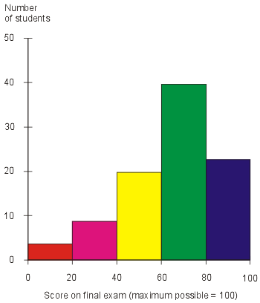
When drawing a pie chart, what information do you need to calculate the size of the angle for each category?
What is discrete/continuous data? Give some examples.
How do you go about choosing class intervals when grouping data for a bar chart/frequency diagram?
What’s important when choosing the scale for the frequency axis?

Slide 2
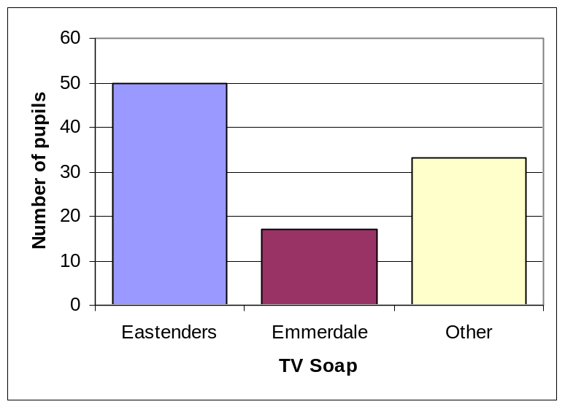
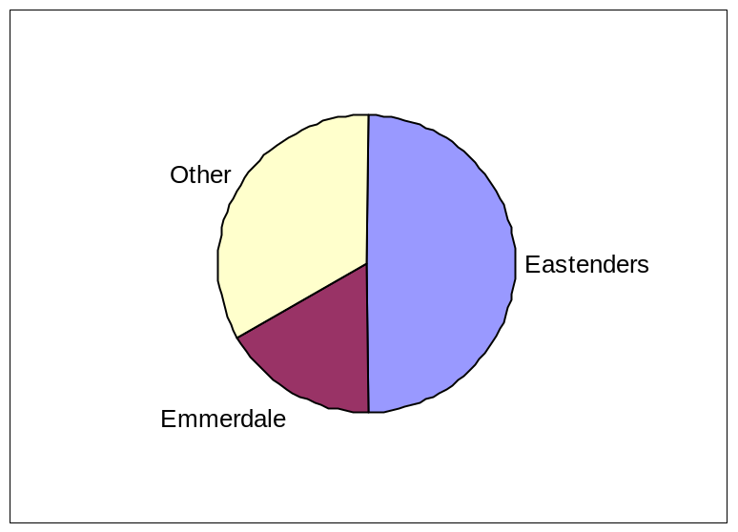
Which is the easiest to interpret? Why?
Would the hypothesis make a difference as to which chart you would use? Why?

